Slide 1
Unsupervised Sparse Dirichlet-Net for Hyperspectral Image Super-Resolution
Ha yeon, KIM
2nd May, 2022

Slide 2
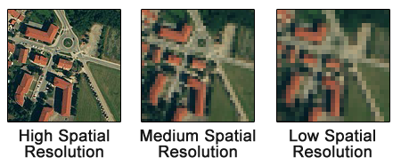

Resolution(trade off)
Spatial Resolution
: detail in pixels of an image
Spectral Resolution
: amount of spectral detail in a band
High spectral resolution means its bands are more narrow
Notes:
하지만 파장을 세분화한 만큼 카메라가 받아들이는 빛에너지의 양이 줄어들어 잡신호(noise)가 상대적으로 커져 공간해상도를 높이기 어렵다.

Slide 3
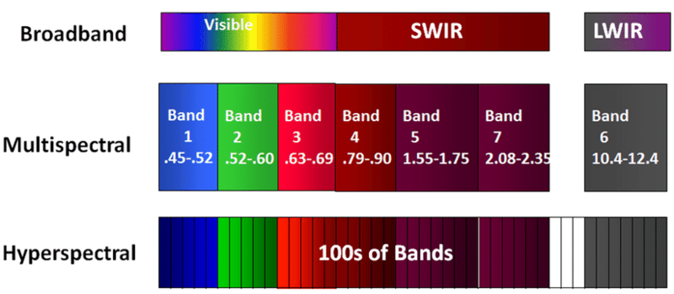
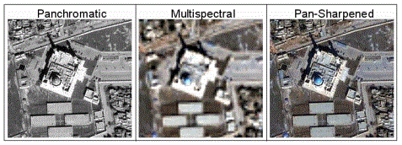
Hyperspectral image super-resolution(HSI-SR)
HSI-SR
hyperspectral image (HSI)
: low spatial resolution (LR)
but high spectral resolution
+
multispectral image (MSI)
: high spatial resolution (HR)
but low spectral resolution
MSI-PAN(multispectral pan-sharpening)
Notes:
HIS는 RGB(band 3개), multispectral image(band 10개정도) 보다 훨씬 많은 수백개의 인접한 band 획득 -> 엄청 디테일적인 spectral signature가지지만, Spatial resolution 은 매우 작음
그래서 둘다 최대한 high resolution을 갖기 위해 HIS-SR방법이 도임 됨.
HIS-SR의 경우, MSI-PAN보다 보존해야할 spectral information이 많으므로, spectral distortion이 일어나기 쉬움
SR : mapping function(LR->HR) 이걸 unsupervised fashion으로!(MSI-PAN 방식 같은 기존 모델은 end-to-end mapping function을 찾아야하고 large dataset을 필요로 하므로)

Slide 4
Hyperspectral image super-resolution(HSI-SR)
uSDN
1. Two encoder-decoder coupled through a shared decoder
-> rich spectral information
(extract spectral, spatial information from LR HIS + HR MSI)
2. Representation follows a sparse Dirichlet distribution
-> incorporate two physical constraints of HSI and MSI
(sum-to-one and sparsity->minimize entropy)
3. Angular difference between representations are minimized
-> reduce spectral distortion
(have similar pattern)
HSI-SR
hyperspectral image (HSI)
: low spatial resolution (LR)
but high spectral resolution
+
multispectral image (MSI)
: high spatial resolution (HR)
but low spectral resolution
Notes:
HIS는 RGB(band 3개), multispectral image(band 10개정도) 보다 훨씬 많은 수백개의 인접한 band 획득 -> 엄청 디테일적인 spectral signature가지지만, Spatial resolution 은 매우 작음
그래서 둘다 최대한 high resolution을 갖기 위해 HIS-SR방법이 도임 됨.
HIS-SR의 경우, MSI-PAN보다 보존해야할 spectral information이 많으므로, spectral distortion이 일어나기 쉬움
SR : mapping function(LR->HR) 이걸 unsupervised fashion으로!(MSI-PAN 방식 같은 기존 모델은 end-to-end mapping function을 찾아야하고 large dataset을 필요로 하므로)

Slide 5
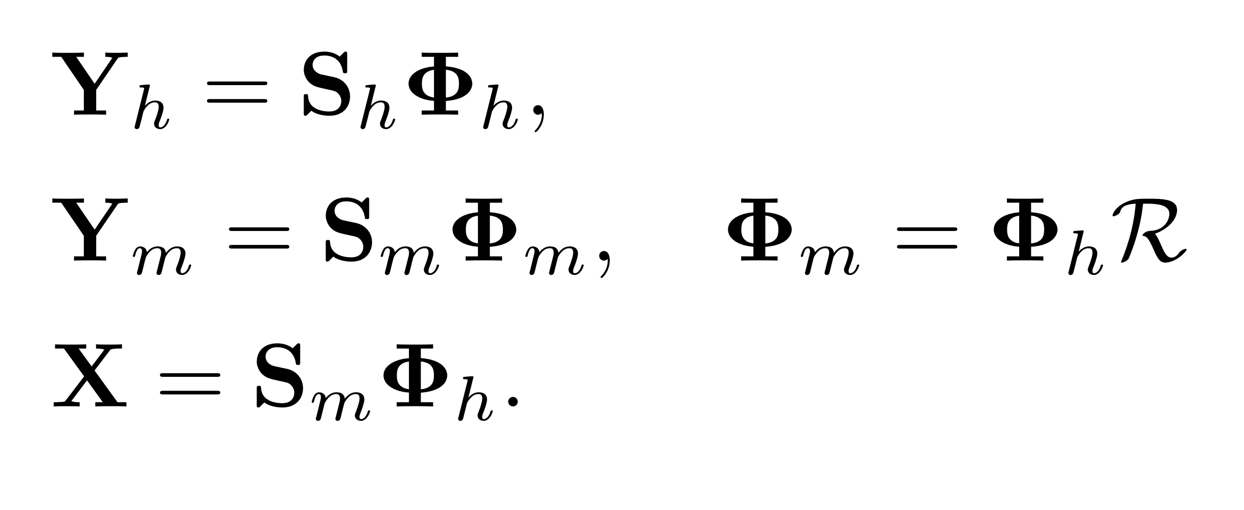





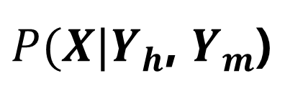

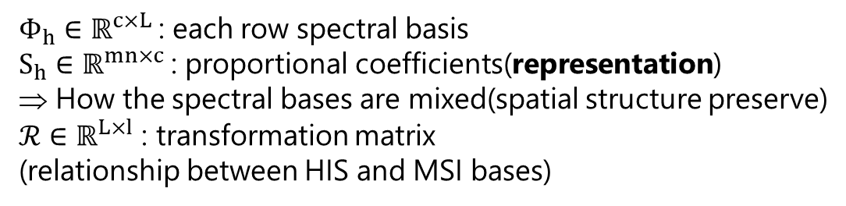

Problem Formulation
LR HSI
$${\overline{Y}}_{h}∈ℝ^{m×n×L}$$
$$Y_{h}∈ℝ^{mn×L}$$
=>
HR HSI
$$\overline{X}∈ℝ^{M×N×L}$$
=>
$$X∈ℝ^{M×N×L}$$
HR MSI
$${\overline{Y}}_{m}∈ℝ^{M×N×l}$$
M>>m, N>>n (high spatial), L>>l(high spectral)
$$Y_{m}∈ℝ^{MN×l}$$
m,n,l : width, height, number of spectral band
3D
2D
$P(X|Y_{h}$, $Y_{m}$)
1. Take advantage of the hared information($Φ_{h}$)
2. Linear combination
<= representation non-negative, sum-to-one
3. Representations should be sparse
4. Spectral distortion should be largely reduced
$Φ_{h}∈ℝ^{c×L}$: each row spectral basis
$S_{h}∈ℝ^{mn×c}$: proportional coefficients(representation)
How the spectral bases are mixed(spatial structure preserve)
$ℛ∈$ $ℝ^{L×l}$ : transformation matrix
(relationship between HIS and MSI bases)
Notes:
C개의 basis vector존재

Slide 6
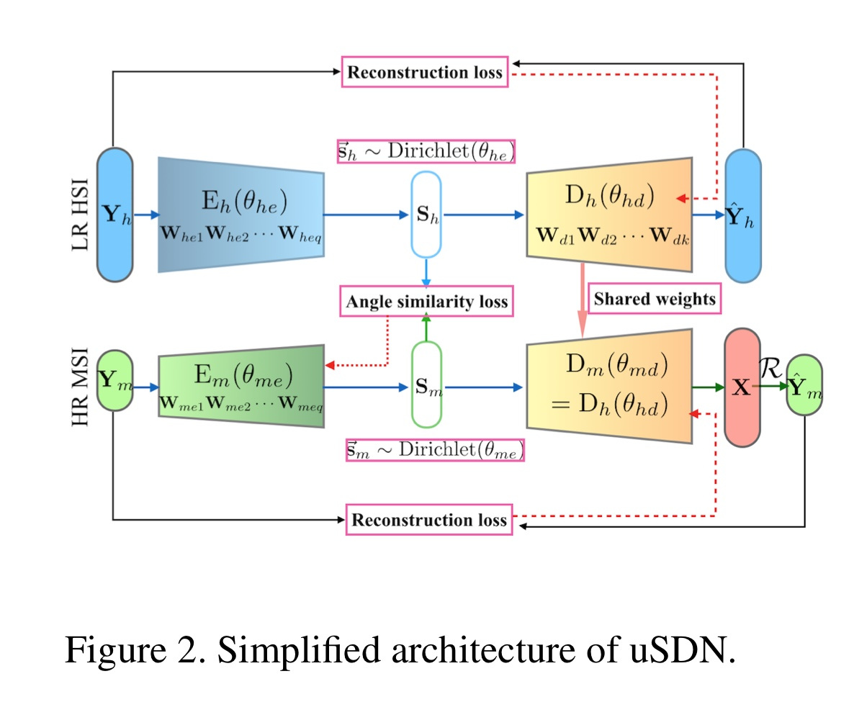
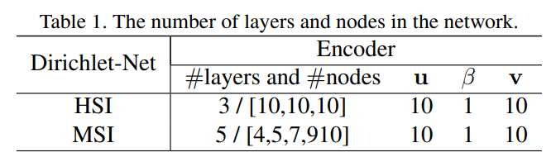



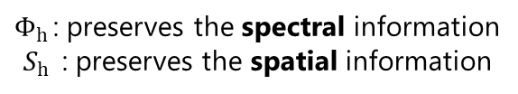

1. Network Architecture
Multiple fully connected layer
$$Φ_{h}$$
Representation
$θ_{md}$= $Φ_{m}$= $θ_{hd}ℛ$=$Φ_{h}ℛ$
l<<L(latent) : MSI = unstable, hard to train
${\hat{Y}}_{m}$= $S_{m}Φ_{h}$ $ℛ$
$Φ_{h }$: preserves the spectral information
$S_{h }$ : preserves the spatial information
$$X=S_{m}Φ_{h}$$
Notes:
만약, activation function=identity function, bias가 없다면 theta_hd = W1W2..Wk => 즉, theta_hd = shared weight(이상한거?h)

Slide 7
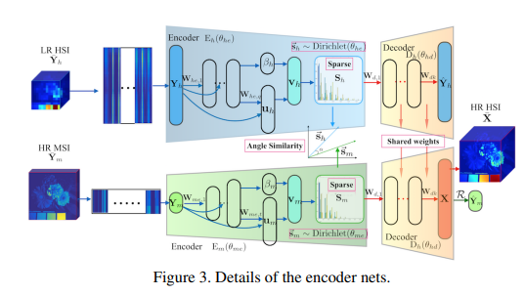
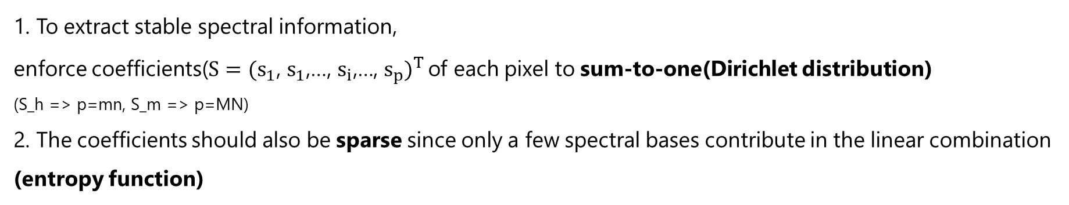
2. Sparse Dirichlet-Net with Dense Connectivity
1. To extract stable spectral information,
enforce coefficients($S={(s_{1}\text{, }s_{1}\text{,…, }s_{i}\text{,…, }s_{p})}^{T}$ of each pixel to sum-to-one(Dirichlet distribution)
(S_h => p=mn, S_m => p=MN)
2. The coefficients should also be sparse since only a few spectral bases contribute in the linear combination
(entropy function)
Notes:
만약, activation function=id두샤쇼 function, bias가 없다면 theta_hd = W1W2..Wk => 즉, theta_hd = shared weight(이상한거?h)

Slide 8




2. Sparse Dirichlet-Net with Dense Connectivity
<Stick-breaking process>
: breaking a unit-length stick into c pieces, the length of which follows a Dirichlet distribution.
Assuming that the generated vector is denoted as s = (s1, · · · , sj , · · · , sc), we have 0 ≤ sj ≤ 1,
and the variables in the vector are sum to one(v0~Beta(u, alpha, beta))
$α$ = 1
Notes:
Beta distributio으로부터 바로 samplin하는 것은 어려움으로 Kumaraswamy distributio의 inverse transform 사용 = Beta distribution(alpha=1, beta=1)
U(0,1사이에 map => sigmoid) 와 beta(beta>0 => softplus)는 network를 통해 학습되는 learned parameter
Beta와 U의 variability를 증가시키기 위해, concat 대신 k번째 레이어의 input은 기존의 weight을 다 더한것으로 사용

Slide 9
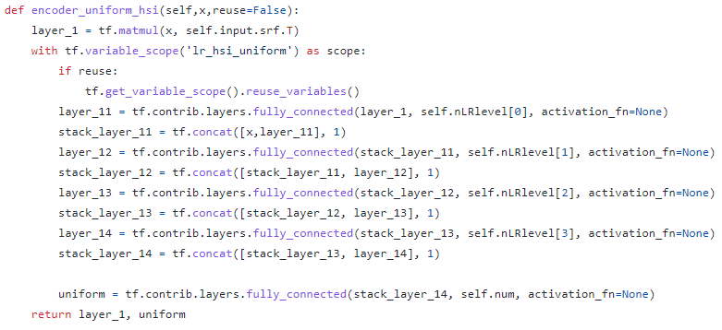
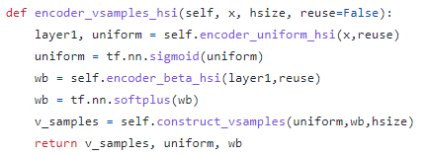
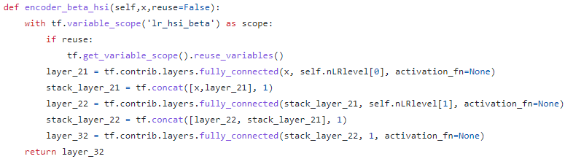
2. Sparse Dirichlet-Net with Dense Connectivity
<Stick-breaking process>
Notes:
Beta distributio으로부터 바로 samplin하는 것은 어려움으로 Kumaraswamy distributio의 inverse transform 사용 = Beta distribution(alpha=1, beta=1)
U(0,1사이에 map => sigmoid) 와 beta(beta>0 => softplus)는 network를 통해 학습되는 learned parameter
Beta와 U의 variability를 증가시키기 위해, concat 대신 k번째 레이어의 input은 기존의 weight을 다 더한것으로 사용

Slide 10
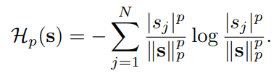
2. Sparse Dirichlet-Net with Dense Connectivity
<Shannon entropy function>
Decrease monotonically when the data become sparse
Local minimum only occurs at the boundaries of the quadrants
Stick breaking process : s>0, so p=1 for efficient
Notes:
Beta distributio으로부터 바로 samplin하는 것은 어려움으로 Kumaraswamy distributio의 inverse transform 사용 = Beta distribution(alpha=1, beta=1)
U(0,1사이에 map => sigmoid) 와 beta(beta>0 => softplus)는 network를 통해 학습되는 learned parameter
Beta와 U의 variability를 증가시키기 위해, concat 대신 k번째 레이어의 input은 기존의 weight을 다 더한것으로 사용

Slide 11
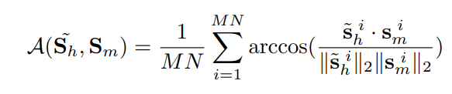

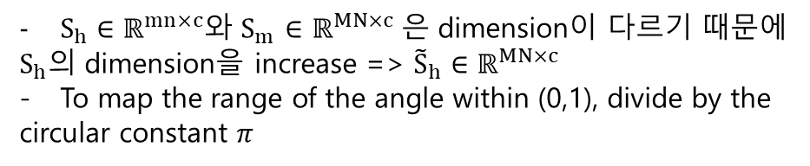
3. Angle Similarity(Representation)
Extract spatial information from HR MSI = challenging, spectral distortion
(c >> l, representation의 수가 MSI의 dimension보다 훨씬 크기 때문에 발생)
=> SAM(spectral angle mapper) 사용, 작을수록 좋음
<Angle Similarity>
<Guarantee for angle similarity>
- Same decoder weight : should have similar angle for high quality image
- Dirichlet distribution : reduce the angular difference
$S_{h}∈ℝ^{mn×c}$와 $S_{m}$ $∈ℝ^{MN×c}$은 dimension이 다르기 때문에
$S_{h}$의 dimension을 increase => ${\tilde{S}}_{h}∈ℝ^{MN×c}$
To map the range of the angle within (0,1), divide by the
circular constant $π$
Notes:
down-sampling function으로 HIS와 MSI사이의 관계를 만드려고 했으나, 잘 안쓰임

Slide 12
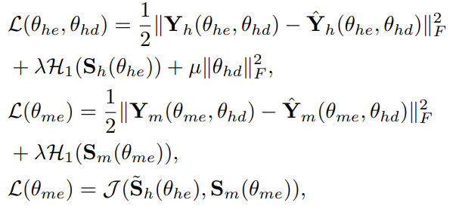
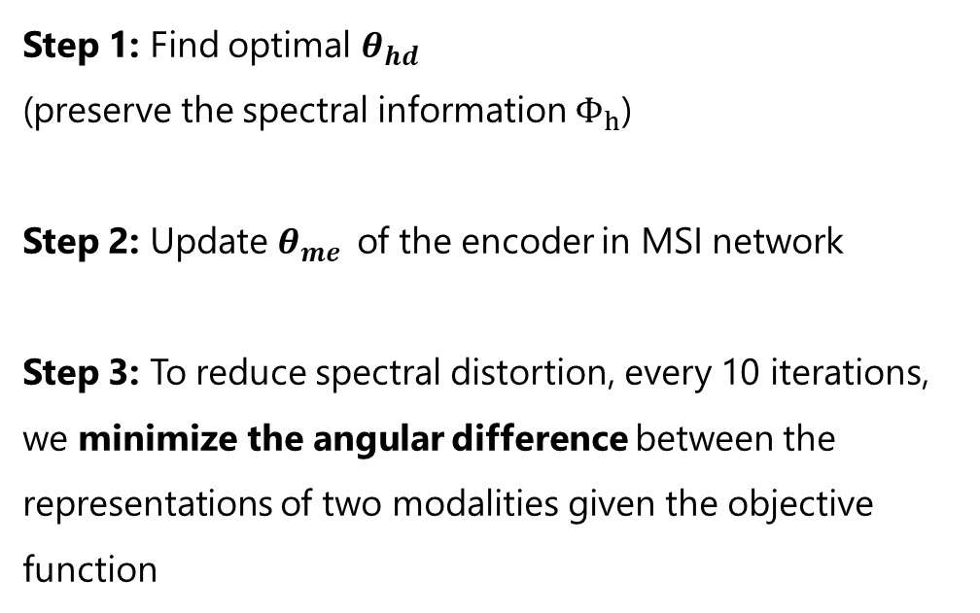
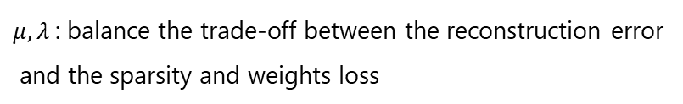
4. Optimization and Implementation Details
<Objective Function>
<Optimization>
Step 1: Find optimal $θ_{hd}$
(preserve the spectral information $Φ_{h}$)
Step 2: Update $θ_{me}$of the encoder in MSI network
Step 3: To reduce spectral distortion, every 10 iterations, we minimize the angular difference between the representations of two modalities given the objective function
$μ,λ$: balance the trade-off between the reconstruction error
and the sparsity and weights loss
Notes:
down-sampling function으로 HIS와 MSI사이의 관계를 만드려고 했으나, 잘 안쓰임

Slide 13
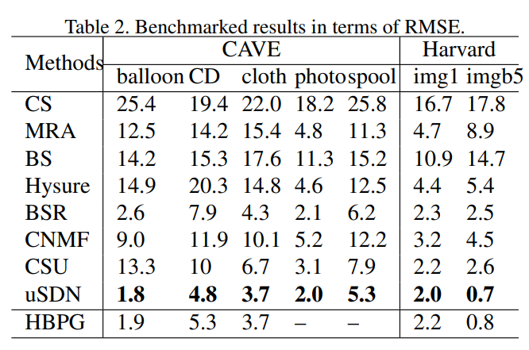
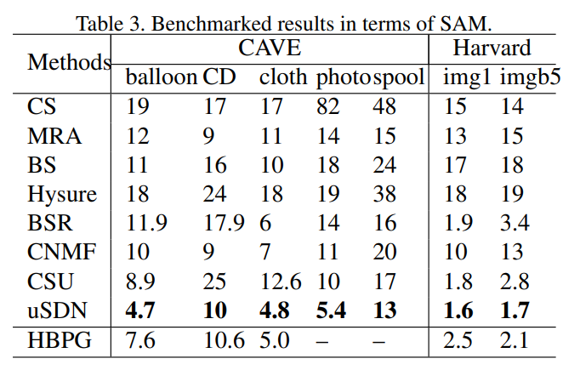
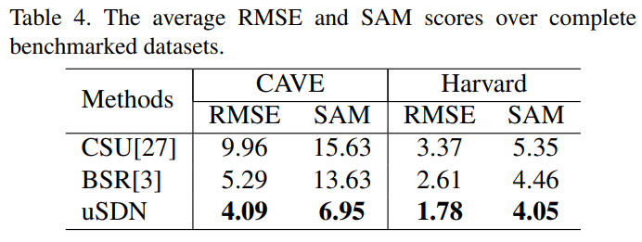
Result
Notes:
Dataset : CAVE, Harvard
Evaluation : RMSE, CAM
Cave dataset이 다루기 더 어려운데 uSDN의 경우에 이때 SOTA보다 훨씬 훌륭하다
uSDN은 HR HIS reconstruction 에서 spectral signature를 보존하는데 매우 탁월

Slide 14
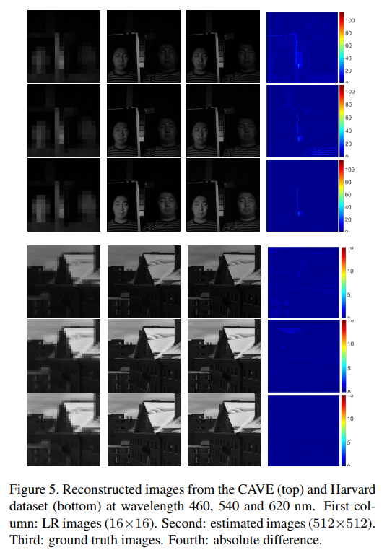
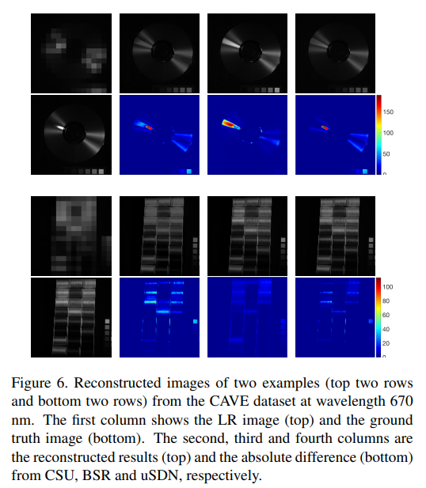
Result
Notes:
Dataset : CAVE, Harvard
Evaluation : RMSE, CAM
Cave dataset이 다루기 더 어려운데 uSDN의 경우에 이때 SOTA보다 훨씬 훌륭하다
uSDN은 HR HIS reconstruction 에서 spectral signature를 보존하는데 매우 탁월

Slide 15
Thank You!

